Slide 1
Some Thoughts on
Health, Fitness, Exercise and their benefits
by
Gofitmantra

Slide 2
Fitness
Physical fitness is a multidimensional state of being. Physical fitness is the body’s ability to function efficiently and effectively. It is a state of being that consists of health-related and skill-related physical fitness components. Each of which contribute to total quality of life.
Need for Fitness
Effective work
Good health
Face emergencies
Enjoyable leisure
Value of fitness
Look good
Feel good
Be healthy

Slide 3
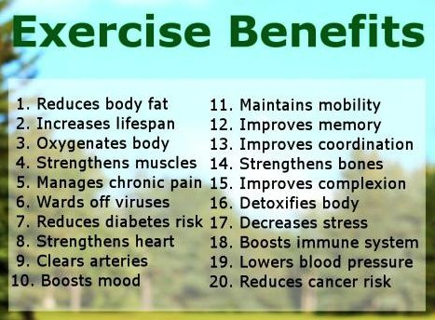
Exercise
Activity requiring physical effort, carried out to sustain or improve health and fitness. Exercise delivers oxygen and nutrients to your tissues and helps your cardiovascular system work more efficiently. And when your heart and lung health improve, you have more energy to tackle daily chores.

Slide 4
Healthy Eating
Healthy eating means eating a variety of foods that "Good For You“ give you the nutrients you need to maintain your health, have energy and feel good. These nutrients include protein, carbohydrates, fat, water, vitamins, and minerals. Nutrition is important for everyone. Eating well along with being active can also lower your risk of disease and help you reach and maintain a healthy weight.
A healthy diet may help to prevent certain serious diseases such as heart disease, stroke and diabetes. It may also help to reduce your risk of developing some cancers. If you become sick, eating a healthy diet may help you to recover more quickly.
What makes up a healthy diet?
As a general rule, vegetables, fruits and starchy foods should provide the bulk of most of your meals. The remaining part of your diet should be made up from milk and dairy foods and protein foods. You should limit the amount of foods and drinks that are high in fat or sugar.

Slide 5
Yoga
The term "yoga" comes from a Sanskrit word meaning "union." Yoga combines physical exercises, mental meditation, and breathing techniques to strengthen the muscles and relieve stress.
BENEFITS OF YOGA
PHYSICAL BENEFITS
Creates a toned, flexible, and strong body
Helps maintain a balanced metabolism
Enhances functioning of respiratory and digestive
Can reduce blood pressure
Improves efficiency of lungs
Enhances sleep endocrine, reproductive and elimination systems
Promotes cardiovascular and circulatory health
Relieves pain and Improves balance
Improves athletic performance, posture and energy level

Slide 6
Yoga
MENTAL BENEFITS
Calms the Mind, Reduces Stress and Anxiety
Attunes us to the Environment
Concentration and Mental Clarity are Enhanced
Encourages positive thoughts and self-acceptance
Promotes Flexibility
SPIRITUAL BENEFITS
Enhances the concept of Oneness of all things
Personal energy connects to divine energy

